Slide 1
ACL Lab
Daphne Camodoc Emily Chase

Slide 2
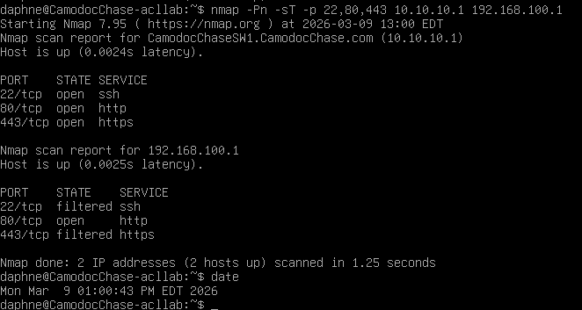
Screenshot 1 nmap vlan1: http open

Slide 3
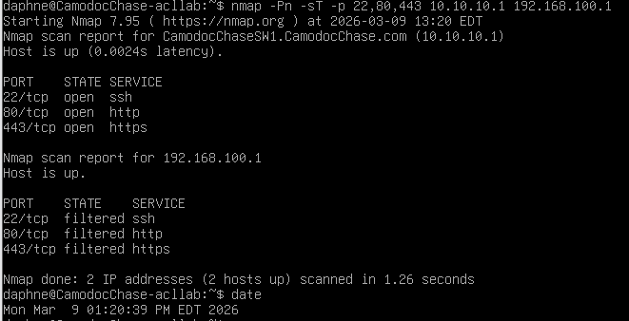
Screenshot 2 nmap vlan1: http filtered

Slide 4
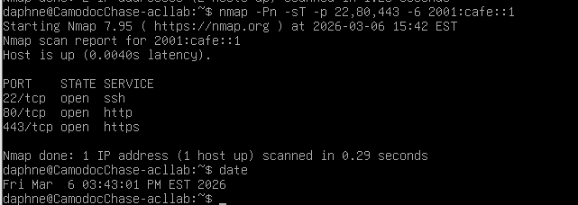
Screenshot 3 loopback scan: all open

Slide 5
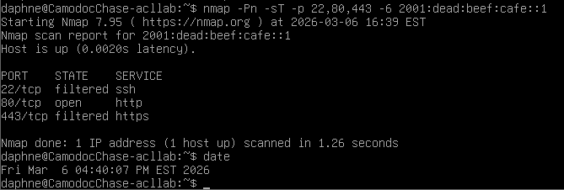
Screenshot 4 VLAN 1 Global v6 80/open

Slide 6
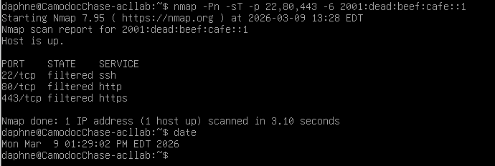
Screenshot 5 VLAN 1 Global v6 80/filtered

Slide 7
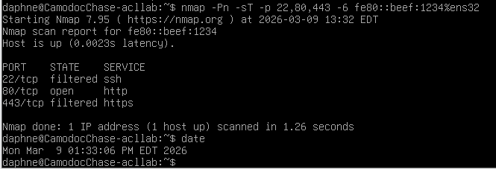
Screenshot 6 VLAN 1 Link-Local v6 80/open

Slide 8
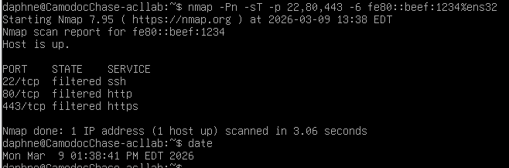
Screenshot 7 VLAN 1 Link-Local v6 80/filtered

Slide 9
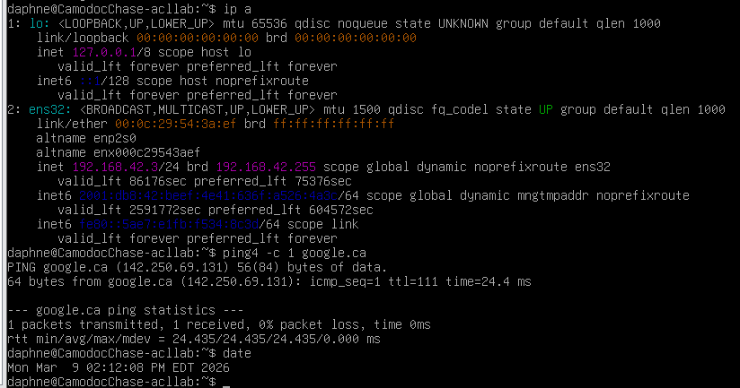
Screenshot 8 VLAN 42 IPv4 Connectivity

Slide 10
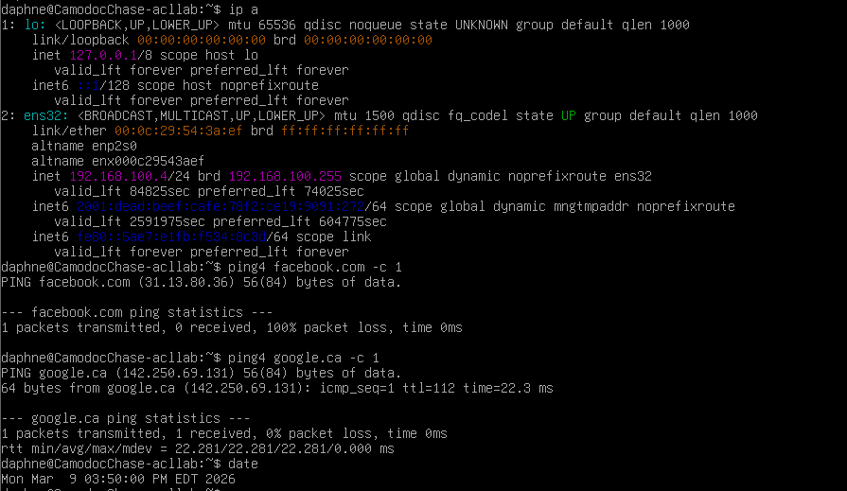
Screenshot 9 VLAN 1 IPv4 ACLs

